Slide 1
Geothermal Reservoirs
By Henry Larson

Slide 2
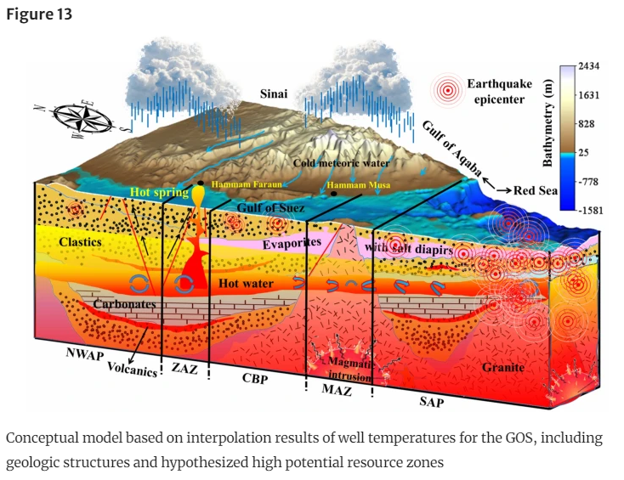
What is a geothermal reservoir?
Powerful energy source:
Uses subsurface water heated by geologic processes. Water is pumped up and used to turn a turbine which then generates electricity.
These waters can reach up to 700℃.
What geologic processes create a viable geothermal resource?
Upwell of magma heats water trapped under the surface.
Pressure and temperature gradient increase with depth heating water.
What makes it a reservoir?
A porous rock the allows the fluid to move throughout that is trapped from coming to the surface.
Masoud, A. A., Kubo, T., & Koike, K. (2023). Detection of thermal features through interpolation of well-log data in low-to-medium enthalpy geothermal system, Gulf of Suez, Egypt. Natural Resources Research, 32(3), 955–980. https://doi.org/10.1007/s11053-023-10160-0

Slide 3
Why is geothermal important?
Renewable.
Lower risk than oil and gas.
Can do many things:
Generate electricity.
Directly heat buildings.
Heat greenhouses.
Warm fish farm waters.
Resource extraction.

Slide 4
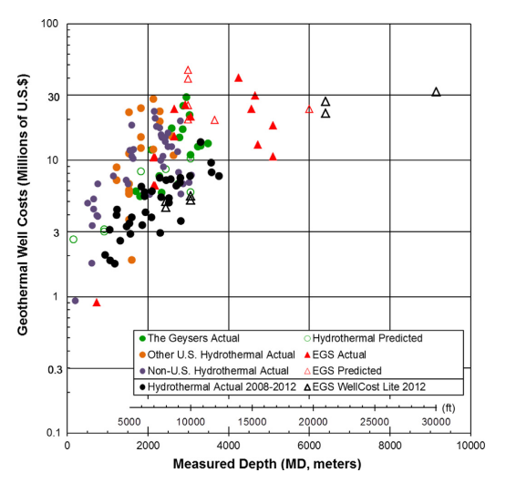
Economics of geothermal
Geothermal uses pre-existing technology.
Less R&D cost.
Oil and Gas wells have to be drilled deeper than geothermal wells in most cases, drives up cost.
Drilling a well costs ~$5,500 per 150 ft.
Improvements in geothermal drilling technology over the last 35 years and has led to much lower cost escalation compared to oil and gas drilling over the same period.
Good geological due diligence can help to reduce costs.
Lukawski, M. Z., Anderson, B. J., Augustine, C., Capuano, L. E., Beckers, K. F., Livesay, B., & Tester, J. W. (2014). Cost analysis of oil, gas, and geothermal well drilling. Journal of Petroleum Science and Engineering, 118, 1–14. https://doi.org/10.1016/j.petrol.2014.03.012

Slide 5
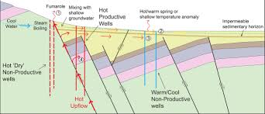
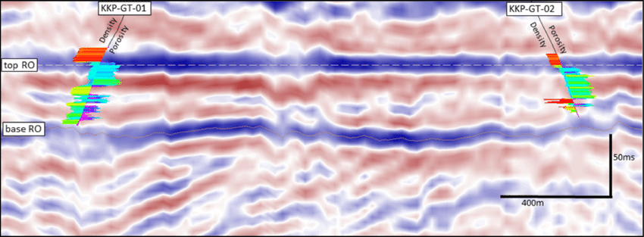
How to find a geothermal resource
Existing geological surveys.
Seismic data and analysis.
Vibrating the earth and measuring the response over time.
Geochemical sampling.
Looking for specific minerals that are indicative of a hot water reservoir.
e.g. Lithium.

Slide 6
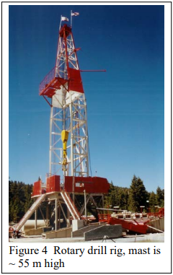
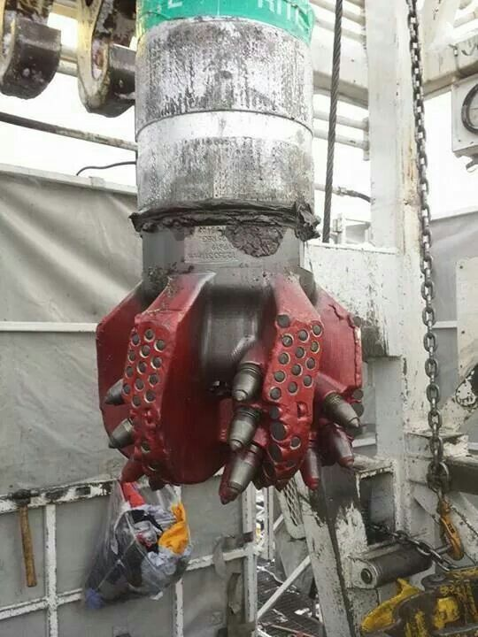
How we get to it
Drilling wells!
This technology already exists: to get to oil and gas reservoirs.
Once a well is drilled they enclose it and can extract the hot water used for geothermal power.
Finger, J., & Blankenship, D. (2010, December). Handbook of Best Practices for Geothermal Drilling | Department of Energy. Energy.gov. https://www.energy.gov/eere/geothermal/downloads/handbook-best-practices-geothermal-drilling

Slide 7
Geologic Environmental Concerns
Pollution.
Water contamination.
Dissolved solids discharged from geothermal systems: sulfur, chlorides, silica compounds, vanadium, arsenic, mercury, nickel and other toxic heavy metals.
Air Pollution.
Greenhouse gasses beneath surface: CO2 & Methane
Hydrogen sulfide can be removed via installing Hydrogen Sulfide Abatement System.
Water usage.
Water needs to be used to run facility elements.
Induced seismicity.
Small earthquakes caused by human activity: drilling & extraction.
Constant monitoring.
Levine, Aaron, and et al. “National Renewable Energy Laboratory (NREL) Home Page.” NREL, 3 Oct. 2017, www.nrel.gov/.

Slide 8
Role-play Scenario
In a small town, a geothermal energy company proposes to drill a well to access a geothermal reservoir for energy production. Concerns and questions arise among the town residents about the safety and potential impacts of the project on their community and environment.
Community Members: Representing the local residents who have concerns about the proposed geothermal project. They raise questions about the safety, environmental impact, and risks associated with drilling and energy production.
Geologists: Representing the experts hired by the geothermal company to address the community's concerns and provide scientific explanations and reassurances about the safety and benefits of geothermal energy. They aim to convince the community members that the project is safe and beneficial for the town's future.
The scenario unfolds as a town hall meeting where community members express their concerns, and geologists respond with scientific evidence and explanations to address those concerns.
Notes:
Role assignment cards
Encourage community members to raise questions and voice concerns about the project's safety, environmental impact, and potential risks.
Geologists should respond to the community members' concerns, providing scientific explanations, data, and examples to reassure them about the safety and benefits of geothermal energy.
After the role-playing scenario, facilitate a discussion among students to reflect on the experience.
Encourage students to share their thoughts on the perspectives they portrayed and the arguments presented by both sides.

